Slide 2
Hosting - Deploying Your Application with CI & CD
Name
Title
Company

Slide 3
Agenda
Amplify Console overview
Connecting a Project & Options
Back end visibility
Setting Up Branched Based Deployments
Setting Up Deployment Previews
Custom Domains and Routing
Demo

Slide 4

Amplify Console Workflow
Connect via:
a git based repository
starter template
static files
Configure CI/CD strategies
Setup custom routing and domains

Slide 5
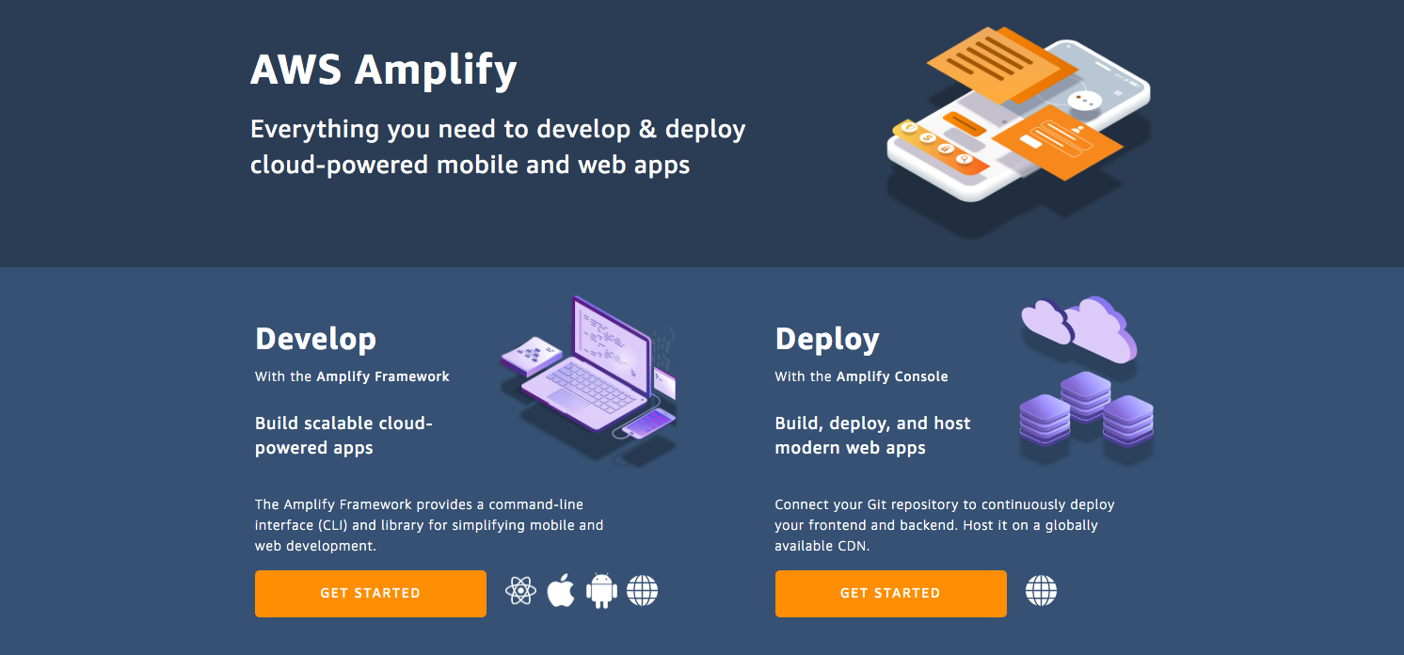
Connecting an App
Create a New App

Slide 6
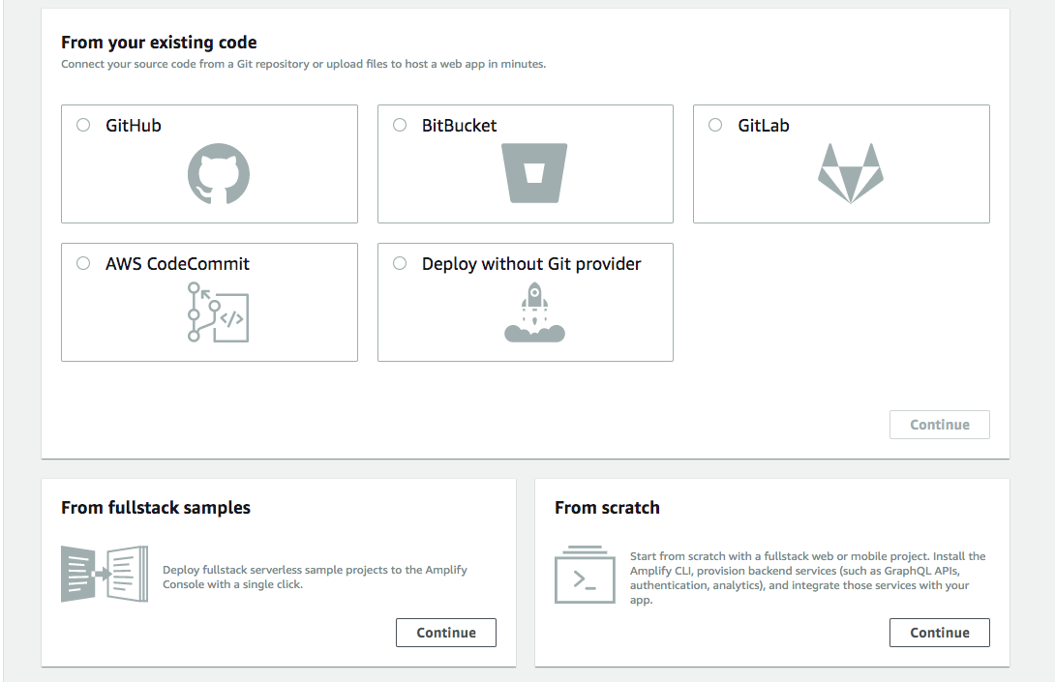
Connecting a client App
Choosing a Provider

Slide 7
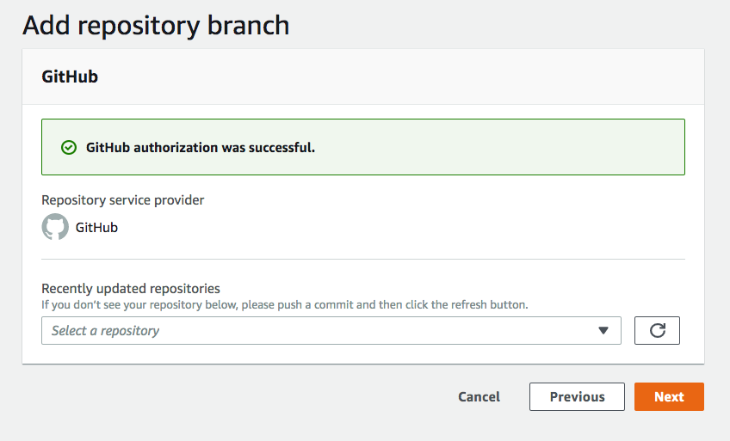
Connecting a client App
Choose a repository

Slide 8
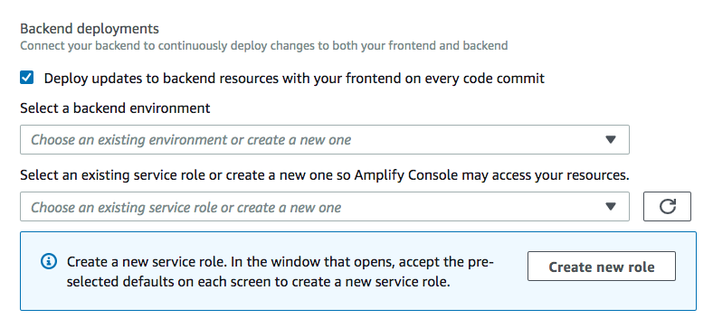
Connecting a client App
Setting Up Backend Configuration

Slide 9
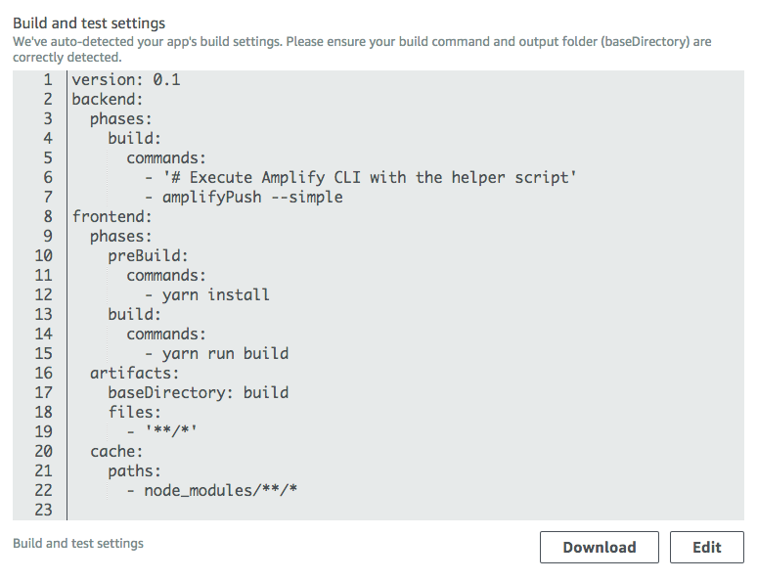
Connecting a client App
Build Settings

Slide 10
Back End Visibility

Slide 11
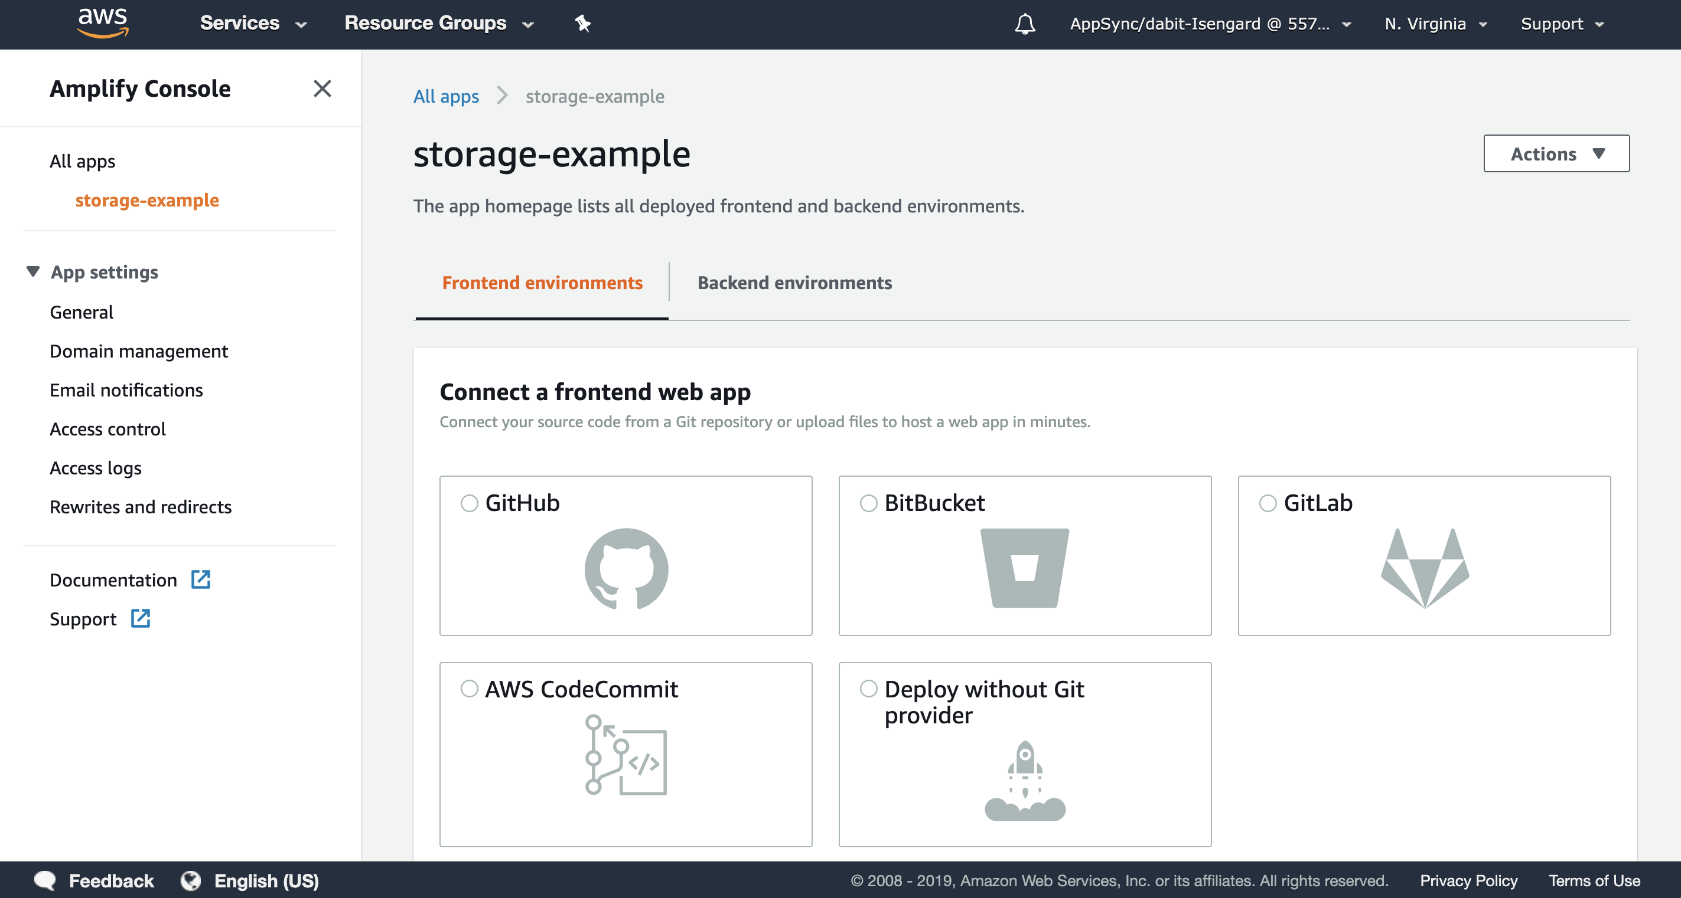

Slide 12
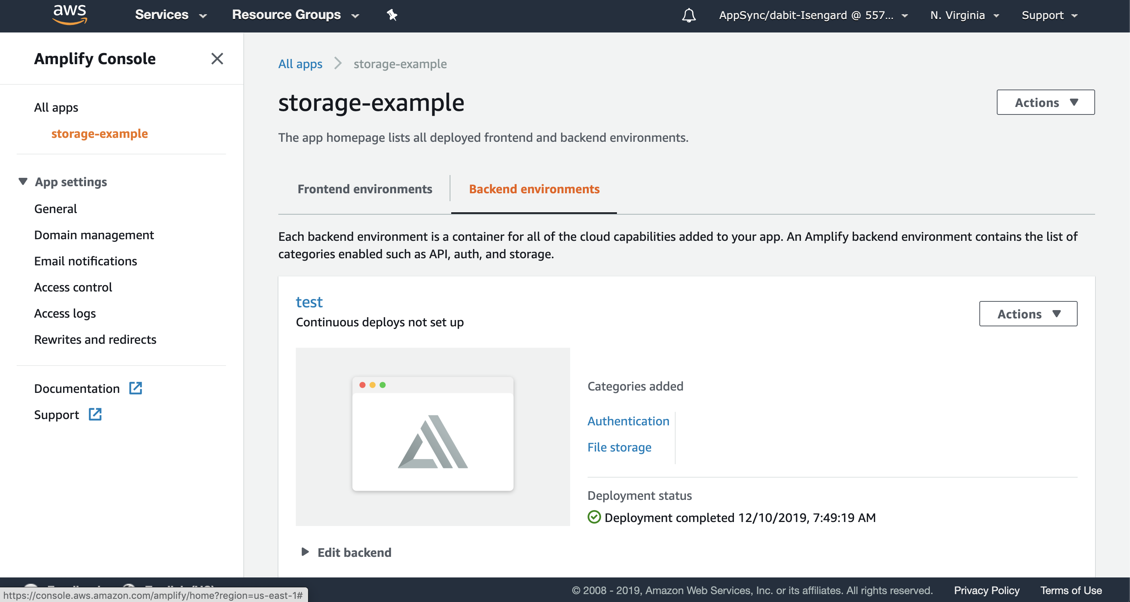

Slide 13
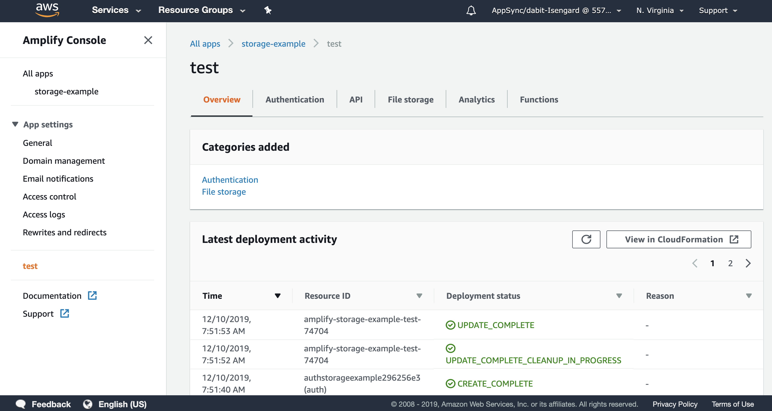

Slide 14
Setting Up Branch Based Deployments

Slide 15
Setting Up Branch Based Deployments
Deployment Options
Autodetection Patterns
Backend Environments
Access Control

Slide 16
Setting Up Branch Based Deployments
Autodetection
Uses regex to set up deployments based on branch names.

Slide 17
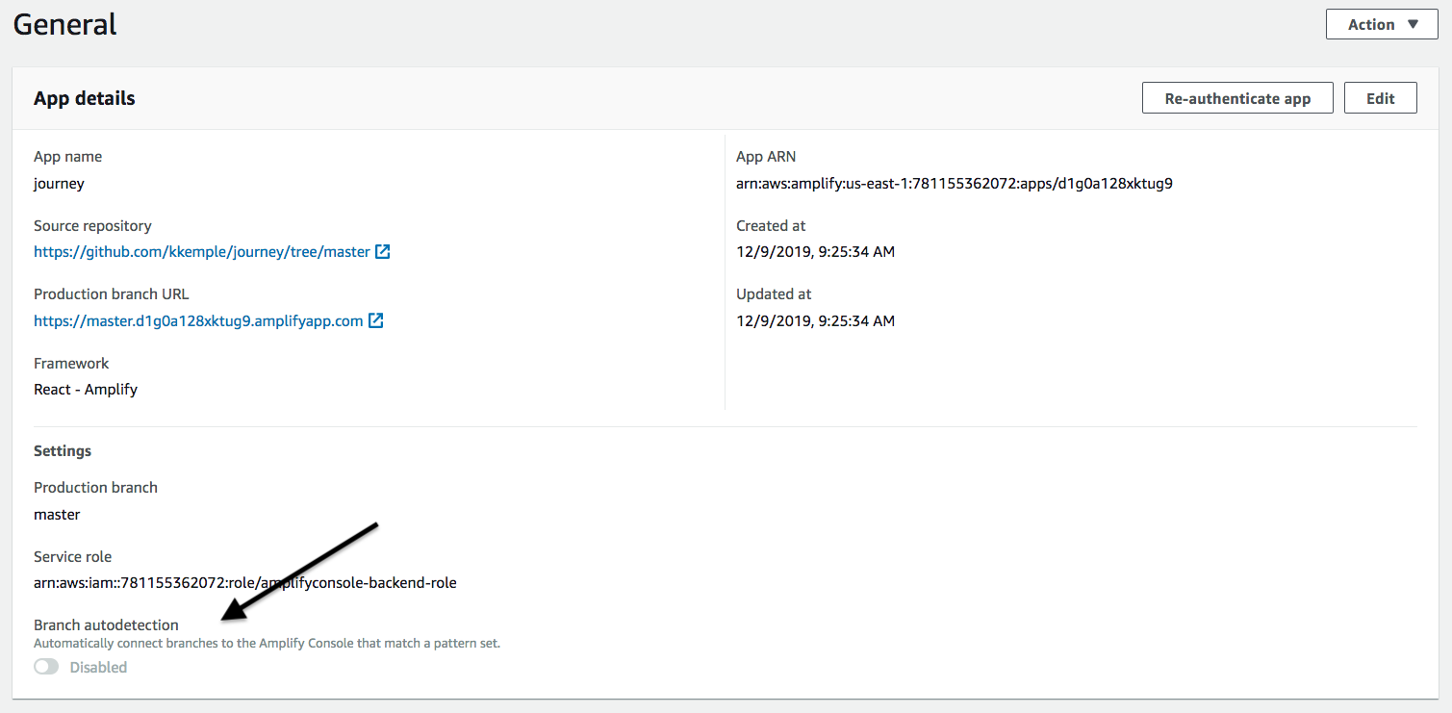
Setting Up Branch Based Deployments
Enable Autodetection

Slide 18
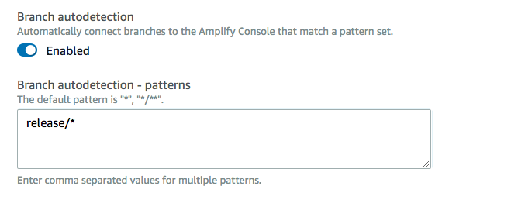
Setting Up Branch Based Deployments
Configure autodetection

Slide 19
Setting Up Branch Based Deployments
Backend Environment
Choose an existing backend environment or create ephemeral backends per deployment

Slide 20
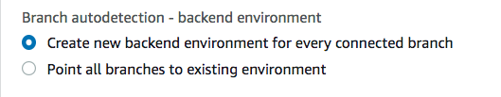
Setting Up Branch Based Deployments
Configure backend environment

Slide 21
Setting Up Branch Based Deployments
Access Control
Restrict access to autodetected branches with a username and password.

Slide 22
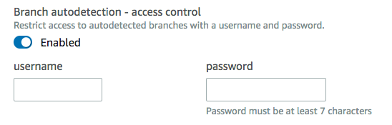
Setting Up Branch Based Deployments
Access Control

Slide 23
Setting Up Deployment Previews

Slide 24
Setting Up Deployment Previews
Git Workflow
Allows Amplify Console to add status updates and links to previews to PRs in git repository.

Slide 25
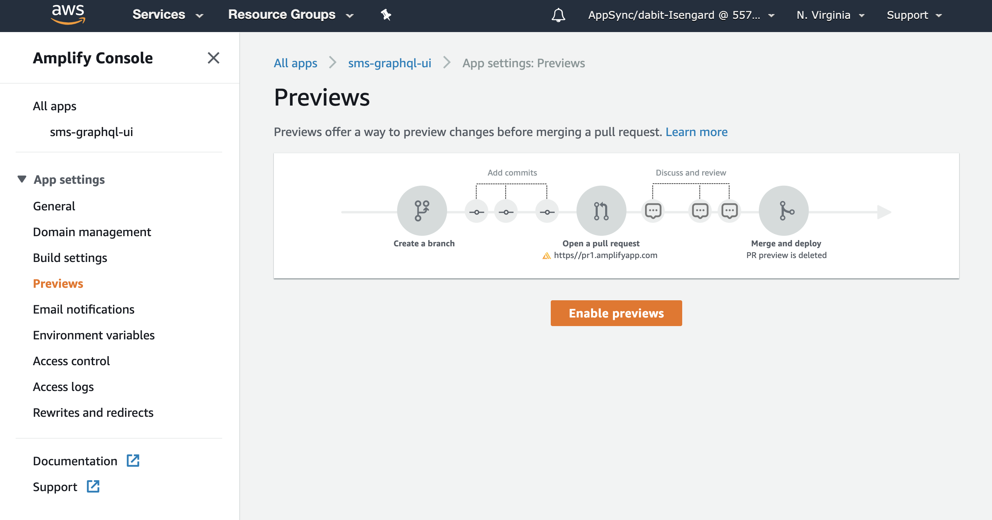
Setting Up Deployment Previews
Install GitHub App

Slide 26
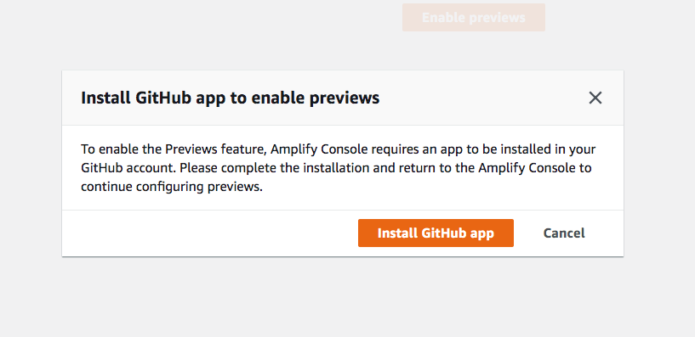
Setting Up Deployment Previews
Install GitHub App

Slide 27
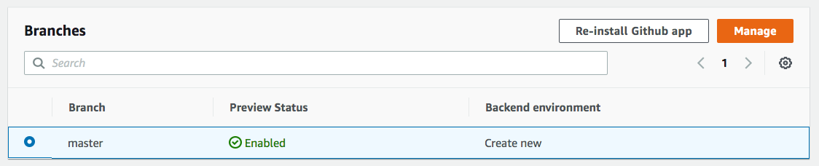
Setting Up Deployment Previews
Select a Branch

Slide 28
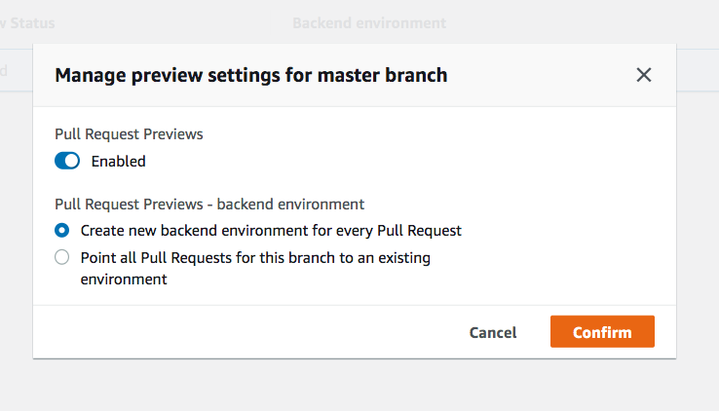
Setting Up Deployment Previews
Backend Environment

Slide 29
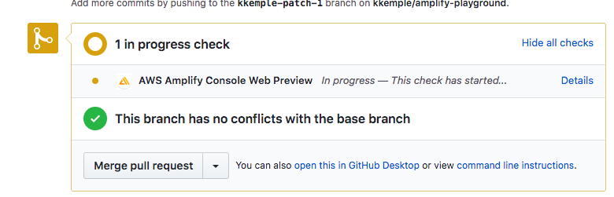
Setting Up Deployment Previews
Status Updates on PRs

Slide 30
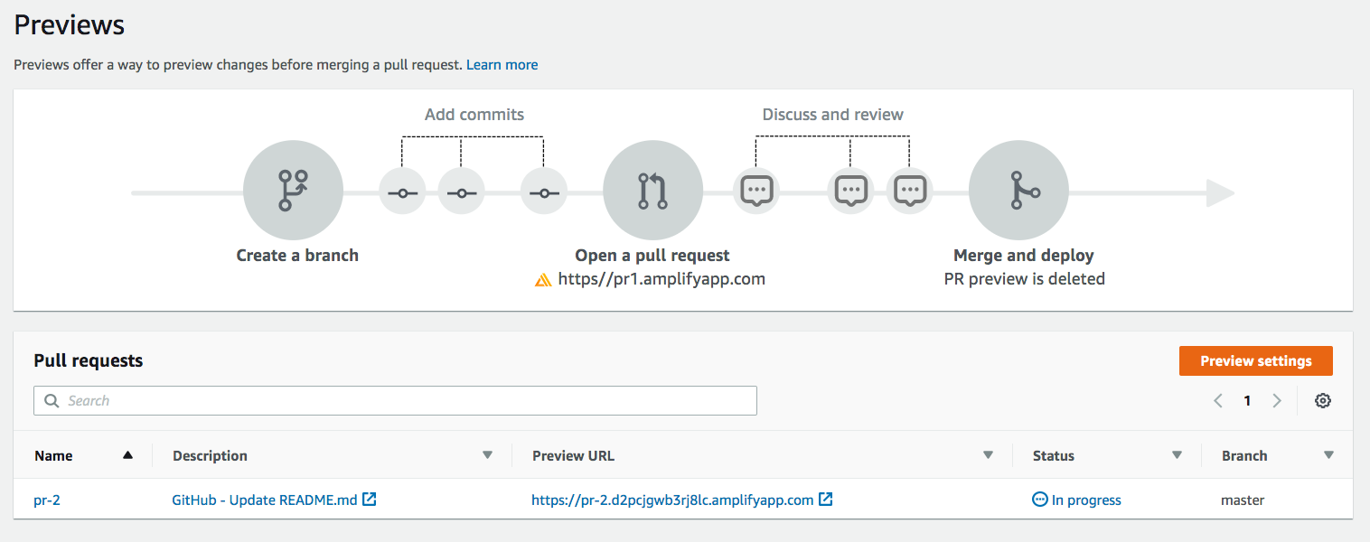
Setting Up Deployment Previews
Viewing Previews in Amplify Console

Slide 31
Custom Domains and Routing

Slide 32
Custom Domains and Routing
Adding Custom Domains
Purchase or configure a domain in Route 53
Add Domain to Your App
Configure Domain Settings

Slide 33
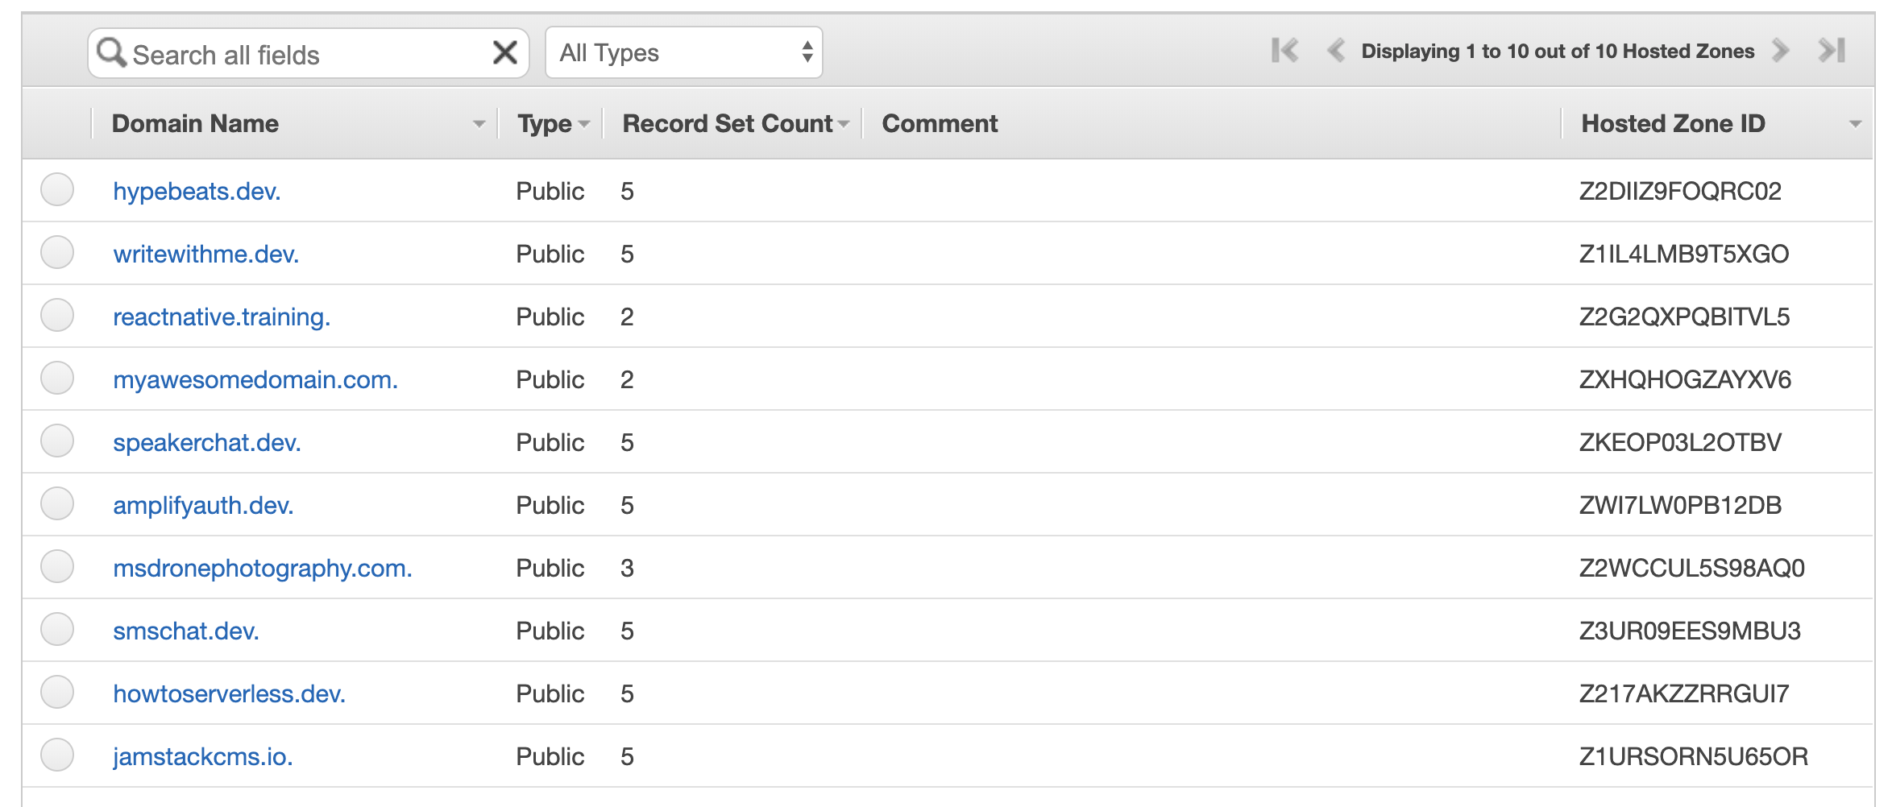
Custom Domains and Routing
Route53

Slide 34
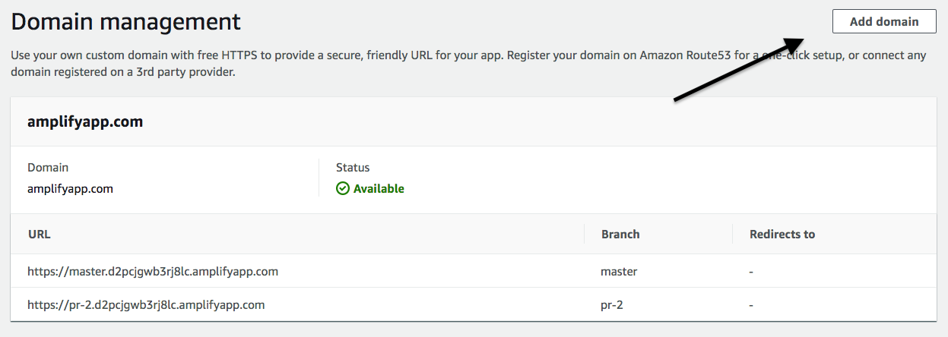
Custom Domains and Routing
Adding a Domain

Slide 35
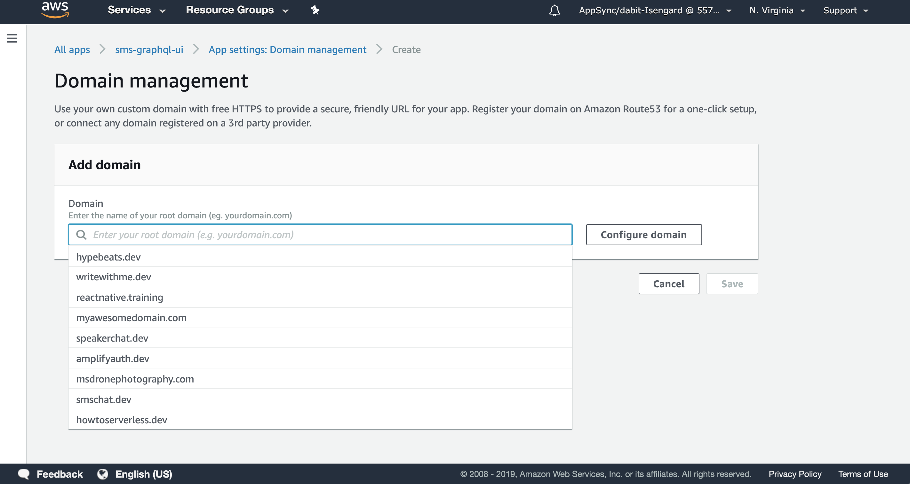
Custom Domains and Routing
Adding a Domain

Slide 36
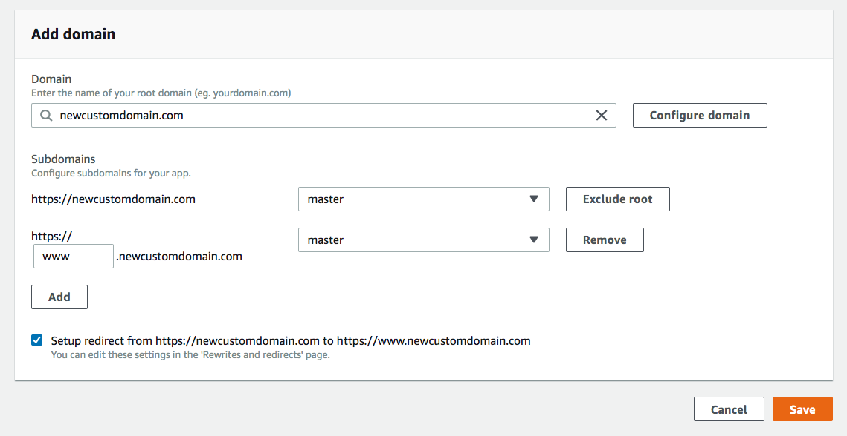
Custom Domains and Routing
Configure Domain Settings

Slide 37
Custom Domains and Routing
Routing
Redirects for SPAs
Reverse Proxy Rewrite
Trailing Slashes and Clean URLs

Slide 38
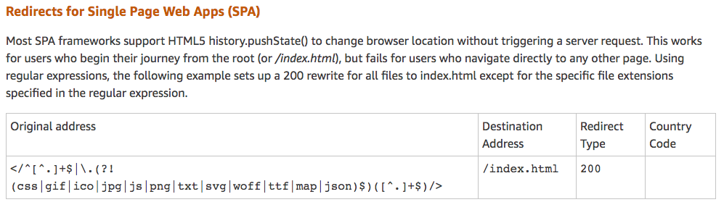
Custom Domains and Routing
Redirects for SPAs
</^[^.]+$|\.(?!(css|gif|ico|jpg|js|png|txt|svg|woff|ttf|map|json)$)([^.]+$)/>

Slide 39
Demo

Slide 40
Name
Title
@handle

